Slide 1
Monterey High School
2022-23
Family Engagement Plan
for Shared Student Success
Plan Revised: May/2022
School Plan for Shared Student Achievement
What is this?
This is a plan that describes how Monterey High School (MHS) will provide opportunities to improve family engagement to support student learning. MHS values the contributions and involvement of families to establish an equal partnership for the common goal of improving student achievement. This plan describes the different ways that Monterey High School will support family engagement and how families can help plan and participate in activities and events to promote student learning at school and at home.
How is this revised?
Monterey High School invites families, teachers, and community members to family engagement meetings throughout the year to review and revise this plan, the family-school compact, and the family engagement budget. Additionally, family input and comments regarding this plan are welcome during the school year through the family-friendly survey which is distributed online and through paper copies. The plan is posted on our school website for families to review during the school year.
Where is this available?
At the beginning of the year, the plan is given to all students. The plan is also posted on the school website and social media. Families can also retrieve a copy of the plan in the MHS Resource Center or the front lobby at MHS.
Who is this for?
Students and families are encouraged and invited to fully participate in the opportunities described in this plan. Monterey High School will provide full assistance for the participation of parents and family members with limited English, with disabilities, and of migratory children.
When students, schools, families, and communities come together-
we CAN achieve our goals!
Monterey High School
Mrs. Sonja Farley, Principal
710 East Commercial Avenue
Monterey, Tn 38574
http://www.montereywildcats.org

Slide 2
Family Engagement
Monterey High School believes that family engagement is the participation of family members in regular, two-way, and meaningful communication involving student academic learning and other school activities. Family engagement should ensure the following:
That families play an integral role in assisting their child’s learning
That families are encouraged to be actively involved in their child’s education at school
That families are partners in their child’s education and are included, as needed, in decision-making and on advisory committees to assist in the education of their child
Family-School Compact
As part of this plan, Monterey High School and our families will develop a family-school compact. A compact is a written agreement that families, teachers, and students jointly develop to explain how everyone will work together to ensure the academic success of students. The compact will be reviewed and updated annually based on feedback from families, students, and teachers during various events and through the annual Family-Friendly Survey. The family-school compact can be viewed on our website and facebook page. Additionally, copies are located in the front office, the MHS Resource Center, and information about our Family-School Compact is on instagram. If you would like to provide feedback on the compact any time during the year, please contact MHS Principal Sonja Farley at (931) 839-2970 -Ext. 2601 or send an email to farleys1@pcsstn.com.

Slide 3
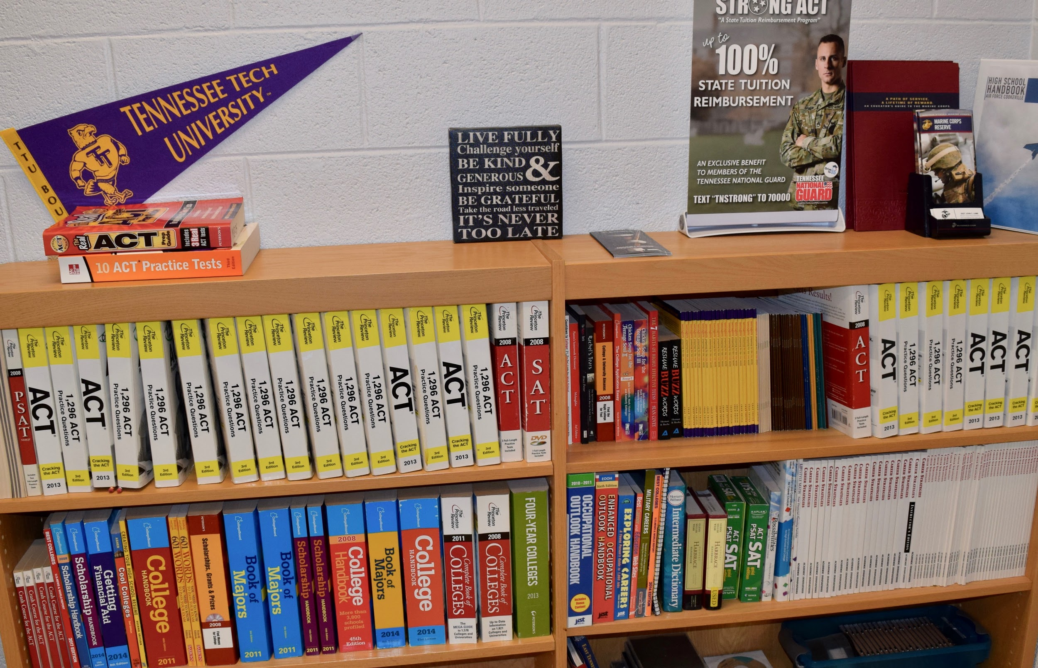
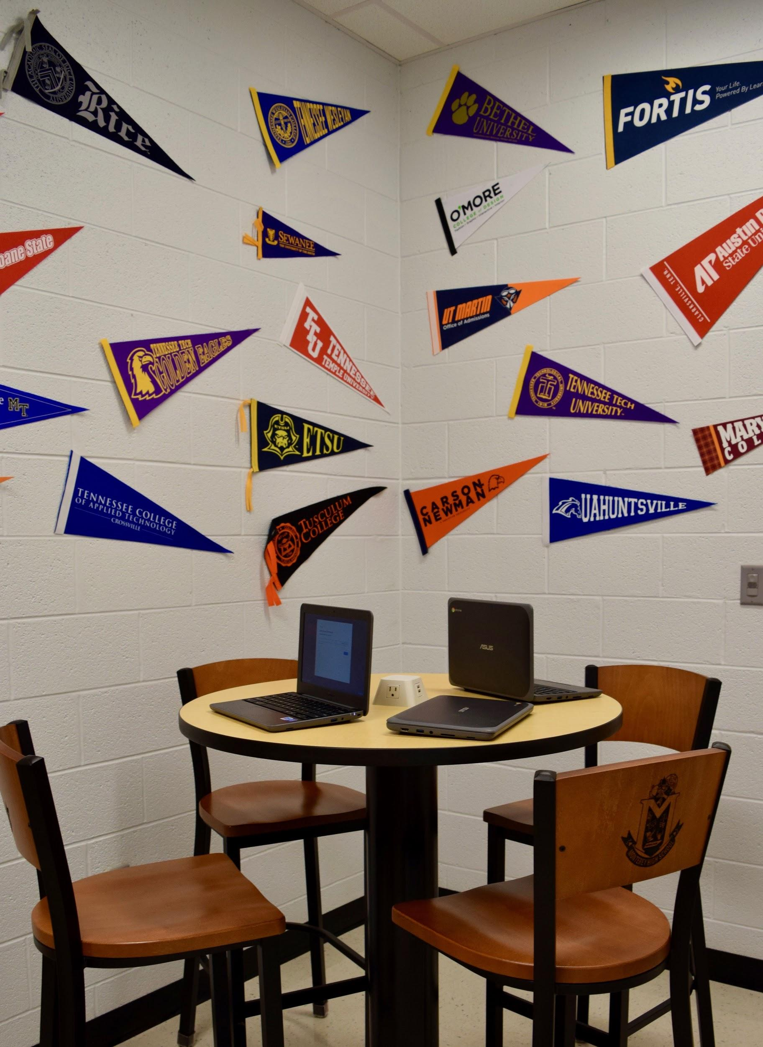
Family Resources
Our MHS Resource Center is located in the Counseling Area. Families and students can access academic information in this area on many topics including careers, colleges, the A.C.T. exam, and the MHS Student Handbook. Computers are also available to explore our website, check Powerschool, and access other educational resources.
Monterey High School will take the following measures to empower and support parents and family members as an important foundation of our school in order to strengthen the school and promote academic achievement.
Goals:
Ensure that all information related to school and family programs, meetings, and other activities is published in both English and Spanish, posted on the school website, and sent home as needed.
Promote and support responsible family dynamics by providing resources such as books, magazines, and other informational tools. These resources can be found in the front lobby at MHS as well as additional materials located in the MHS Resource Center.
Sponsor seminars to inform families on how to be involved in the decisions affecting course selection, career planning, and preparation for post-secondary opportunities.
Provide necessary materials and handouts for family at conferences, meetings, and activities to help families work with their child to improve their child’s achievement.
Communicate with all families and the community on a regular basis regarding school-wide events and activities through phone messages, our website, social media, and/or flyers.
Collect feedback from parents and family members at all events and through the Family-Friendly survey-- then implement changes and improvements based on this feedback.
Monterey High School is committed to helping parents and family members attend the family events listed in this policy. Please call (931) 839-2970--Ext. 2601 or email (farleys1@pcsstn.com) Principal Farley if you need assistance with childcare or transportation in order to participate in any of our programs.

Slide 4
Let’s Get Together!
Monterey High School will host the following events to build the capacity for strong family engagement, support, and partnership among the school, families, and the community to improve student academic achievement.
Parent-Teacher Conferences
7th, 8th, and 9th Grade Orientation Night
10th and 11th Grade Orientation Night
Senior Information and Financial Aid Night
Financial Aid Sessions
Teen Social Trends Night
A.C.T. Cram Session with a Focus on Math and Reading
Rising Freshman Night
Rising 7th Grade Night
Athletic Banquets
Awards Assembly
Blood Drives
Career Fair
Drama and Musical Performances
Veterans Day Program
And More!
***Due to Covid-19, scheduled events may be postponed, canceled, or reformatted to provide information, resources, and materials to students and their families.

Slide 5
School Community Team/Optional to Return
Monterey High School invites all families to join the Family Engagement Committee to share ideas and ways to involve others to build partnerships with school, families, and the community. The team will meet three times during the school year, but parents and family members can also submit ideas or suggestions at school activities and meetings, as well as through our family friendly survey. If you would like to learn more about the Family Engagement Committee, please contact MHS Principal Sonja Farley at (931) 839-2970--Ext. 2601 or email her at farleys1@pcsstn.com. We also welcome feedback through the survey below. This can be turned in to your child’s homeroom teacher, advisement teacher, or the school office.
Family Engagement Committee
Yes, I wish to serve on the Family Engagement Team for the 2022-23 school year.
Name: ___________________________________________________________
Child’s Name and Grade Level: ____________________________________________________________
Address: ___________________________________________________________________________________________________
Phone Number: __________________________________________________________________
Email Address: ___________________________________________________________________
Share Your Thoughts
We want to hear from you! If you have any suggestions or if there is any part of this policy that you feel is not satisfactory with the students’ and school’s goals for academic achievement, please provide us with your comments in the space provided, and leave this form in the front office:
Name (optional): ____________________________________ Phone Number (optional): __________________________
Comments: ___________________________________________________________________________________________________________
___________________________________________________________________________________________________________

