Slide 1
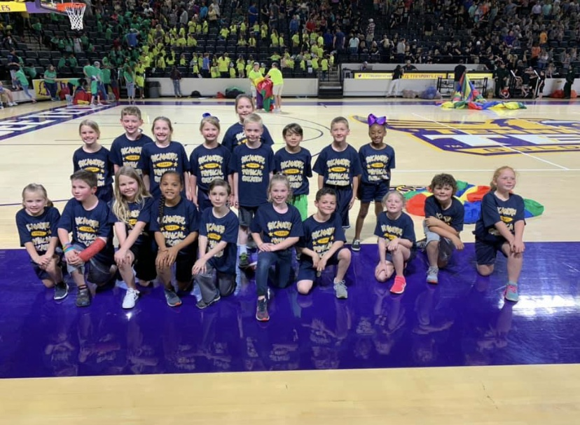
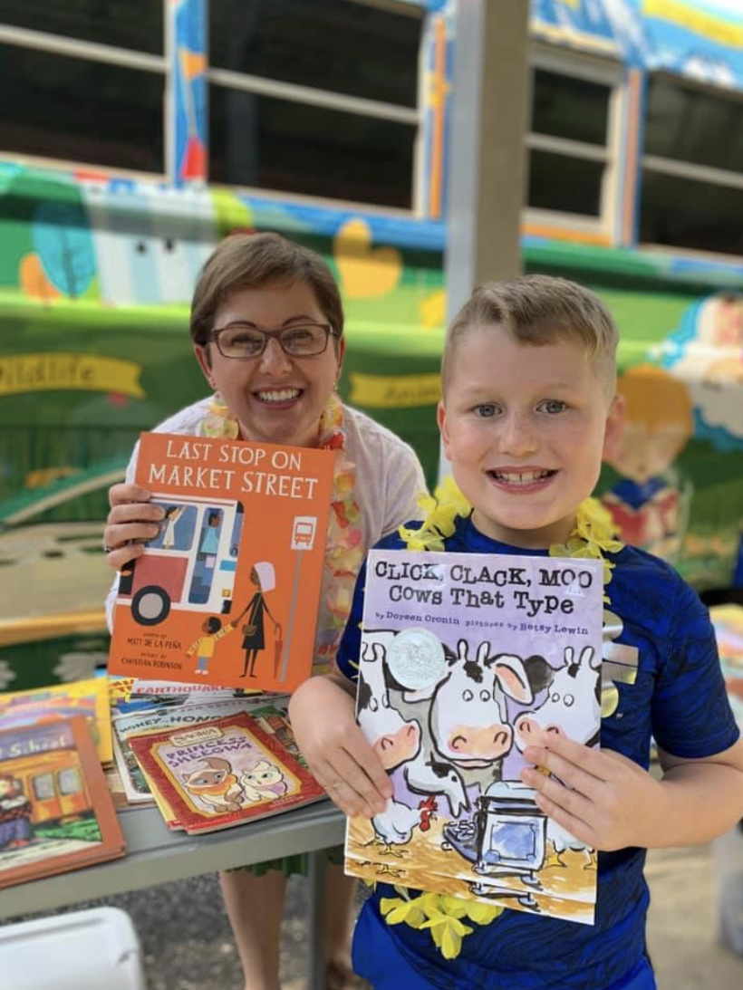
Sycamore Elementary
2023-2024
Parent and Family Engagement Policy for Shared Student Success
Plan Revised 12/14/22
School Plan for Shared Student Achievement
What is it?
This is a plan that describes how Sycamore Elementary will provide opportunities to improve family engagement to support student learning. Sycamore Elementary values the contributions and involvement of families to establish an equal partnership for the common goal of improving student achievement. This plan describes the different ways that Sycamore Elementary will support family engagement and how families can help plan and participate in activities and events to promote student learning at school and at home.
How is it revised?
Sycamore Elementary School invites parents, teachers, and community members to family engagement meetings throughout the year to review and revise this parent and family engagement policy, our school-parent compact, and the family engagement budget. Additionally, family input and comments regarding this plan are welcome during the school year through the family-friendly survey, which is distributed online and through paper copies. The plan is posted on our school website for families to review during the year and will be used to revise the plan for the next school year.
What is it for?
All students participating in the Title I, Part A program and their families are encouraged and invited to fully participate in the opportunities described in this plan. Sycamore Elementary will provide opportunities for the participation of parents and family members with limited English, with disabilities, and of migratory children.
Where is it available?
At the beginning of the year, the plan is included in the student handbook and given to all students. The plan is also posted on the school website and social media. Families can also view a copy of the plan in the Family Resource Center.
What is Title 1?
Sycamore Elementary is identified as a Title I School as part of the Every Student Succeeds Act (ESSA). Title I is designed to support State and local school reform efforts tied to the challenging State academic standards to improve teaching and learning for students. Title I programs must be based on effective means of improving student achievement and include strategies to support family engagement. All Title I schools must jointly develop with parents and family members a written parent and family engagement policy.
When students, schools, families, and communities come together-we CAN achieve our goals!
Sycamore Elementary
Mrs. Tracy Nabors, Principal
452 Ellis Ave.
Cookeville, TN 38501
(931) 526-9322
http://www.sycamorestars.com/

Slide 2
District Goals
1. All Means All
2. Improve College and Career Readiness
3. Academic Success for All
Sycamore Elementary Goals
Goal 1: All Means All To support academic achievement, SES will provide behavioral and social-emotional services to support all students based on need as determined by Dibels, MAP, discipline,
social-emotional rating scales, surveys, and attendance data
.
Goal 2: Improve College and Career Readiness
Through the school counseling program, Sycamore Elementary will introduce students to different types of career opportunities. This will help them, later on, to decide what
field they want to explore and help to determine what career choices they will make when they are older.
Goal 3: Academic Success for All
SES has identified the instructional focus: all students reading, writing, speaking and learning on grade-level in ALL subject areas. Level 3 Achievement. Align resources to
meet district goals. Increase MAP achievement and growth. Increase DIBELS growth and achievement. Sycamore will support teachers in delivering strong instruction and having
high expectations for all students using engaging, grade-appropriate tasks and assignments in all subject areas. Student annual performance will reflect both increased
achievement and growth as a result of strengthened instruction.
Parent and Family Engagement
Sycamore Elementary believes that family engagement means the participation of parents and family members in regular two-way, meaningful communication involving student academic learning and other school activities, including ensuring:
That parents play an integral role in assisting their child’s learning.
That parents are encouraged to be actively involved in their child’s education at school
That parents are full partners in their child’s education and are included, as appropriate, in decision-making and on advisory committees to assist in the education of their child.
School-Parent Compacts
As part of this plan, Sycamore Elementary and our families will develop a school-parent compact. A compact is a written agreement that families, teachers, and students jointly develop to explain how everyone will work together to ensure all students reach grade-level standards. The compacts will be reviewed and updated annually based on feedback from families, students, and teachers during various events and the annual Family-Friendly Survey. The school-parent compacts are shared with parents during parent-teacher conferences, are posted on our school website (http://www.sycamorestars.com/), and extra copies are always available in the front office. If you would like to provide feedback on the compact any time during the year, please contact Jennifer Phillips at (931) 526-9322 or phillipsj6@pcsstn.com.
Title 1
School-Parent Compact

Slide 3
Let’s Get Together!
Sycamore Elementary will host the following events to build the capacity for strong family engagement and support and partnership among the school, families, and the community to improve the student academic achievement.
Back to School Bash August
Parent/Teacher Conferences September
4th Grade Night September
3rd Grade Night October
2nd Grade Night November
1st Grade Night November
Parent/Teacher Conferences February
Sycamore Scramble April
Kindergarten Transition April
4th Grade Transition May
4th Grade Graduation May
Parent and Family Engagement Standards
Sycamore Elementary has adopted the National PTA Standards for Family-School Partnerships as the school’s model for engaging parents, students, and the community. These standards are
Welcoming All Families
Communicating Effectively
Supporting Student Success
Speaking Up for Every Child
Sharing Power
Collaborating with Community

Slide 4
School Community Team
Sycamore Elementary School invites all families to join the Family Engagement Committee to share ideas and ways to involve others to build partnerships with school, families, and the community. The team will meet three times during the school year, but parents and family members can also submit ideas or suggestions at any school activities and meetings, as well as through our family friendly survey and website. If you would like to learn more about the Family Engagement Committee, please contact Jennifer Phillips at (931) 526-9322 or phillipsj6@pcsstn.com. We also welcome feedback through the survey below. It can be turned in to your child’s teacher or the school office.
Family Engagement Committee
Yes, I am interested and wish to join the Family Engagement Committee.
Please contact me so I can learn more about joining the Family Engagement Committee.
Please send me notifications about future meetings and updates.
Name: ___________________________________________________________________________________________
Child’s Name and Grade Level: ____________________________________________________________________
Address: ________________________________________________________________________________________
Phone Number: __________________________________________________________________________________
Email Address: __________________________________________________________________________________
Share Your Thoughts
We want to hear from you! If you have any suggestions or if there is any part of this policy that you feel is not satisfactory with the students’ and school’s goals for academic achievement, please provide us with your comments in the space provided and leave this form in the front office:
Name (optional): ______________________________________ Phone Number (optional): _________________________________
Comments: ___________________________________________________________________________________________________________
___________________________________________________________________________________________________________

Slide 5
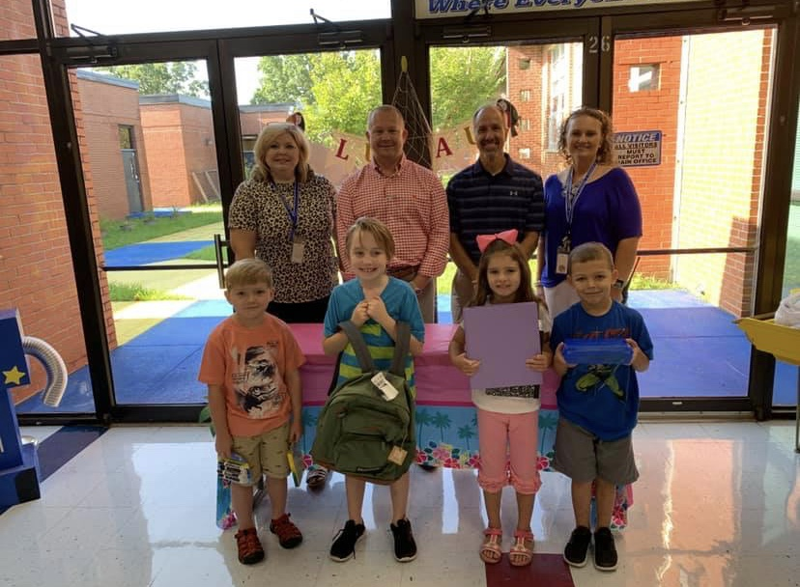
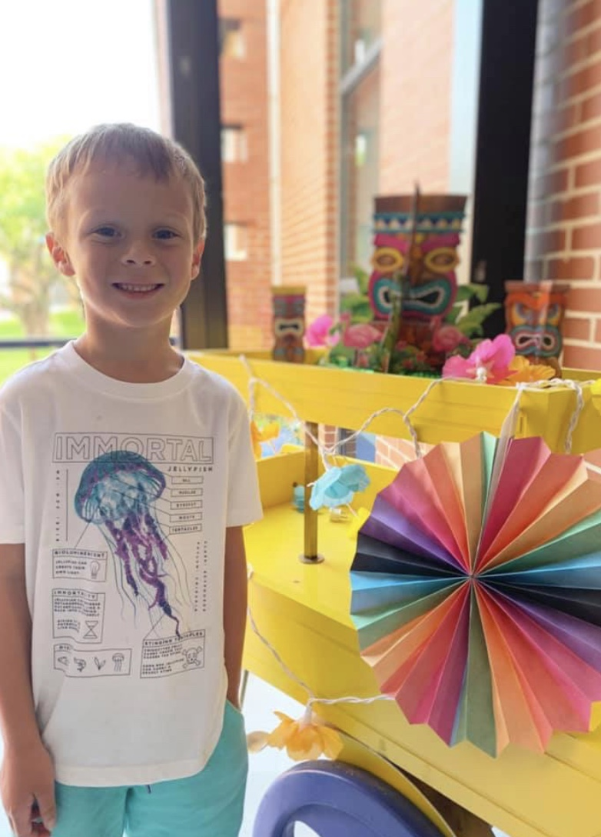
Sycamore Elementary will take the following measures to empower and support parents and family members as an important foundation of our school in order to strengthen the school and reach our goals.
We will:
Ensure that all information related to school and family programs, meetings, and other activities is published in both English and Spanish, posted on the school website, and included in the grade-level newsletters for all families.
Partner with early childhood programs, middle and high schools, college and career ready resources or organizations, parent resource centers, or other programs to help prepare parents and their children for successful school transitioning.
Share information in English and Spanish in the grade level newsletters for families to understand the school’s academic standards and assessments as well as ways families can monitor their child’s progress and work with educators.
Communicate with all families and the community on a regular basis regarding school-wide events and activities through phone messages, our website, social media, and flyers.
Provide necessary materials and handouts for parents at conferences, meetings, and activities to help parents work with their child to improve their child’s achievement.
Collect feedback from parents and family members at all events and through the Family-Friendly survey.
Family Resources
The Family Resource Center in Room 102 is available Mon-Fri. from 7:45-8:00 and 2:45-3:15. Families can check out books, games, DVDs, flash cards, etc. to use at home with their students. Computers are also available to explore the Powerschool Parent Portal and educational resources.
Sycamore Elementary is committed to helping parents and family members attend the family events listed in this policy. Please call or email us if you need assistance with childcare or transportation in order to participate in any of our programs.
Jennifer Phillips, Family Liaison
(931) 526-9322
phillipsj6@pcsstn.com

